Slide 1
Safety Culture
What is Safety Culture and How Can it Help Improve Dam Safety?
Presented by: Ahmad Faramarzi, PE, PMP
Analysis Planning and Management Institute, Inc.
Notes:
Introduction of bio by facilitator
Mr. Ahmad Faramarzi is a multidisciplinary scientist and engineer with 38 years of experience providing expertise to U.S. Federal agencies and private sector. Over the course of his career, he has played a key role in ensuring efficacy and safety of power plants, defense nuclear facilities, disassembly of nuclear and chemical weapons, planetary satellites operations, environmental remediation technologies, water resources projects, and counter-terrorism technologies. His primary areas of interest are risk/safety analysis and management, and R&D. Ahmad holds a BS in Nuclear Engineering, an MS in Mechanical Engineering, and an Engineer Degree with specification in fluid mechanics and thermal science.

Slide 2
Context
Presentation is based on a paper co-authored by:
  Ahmad Faramarzi, PE (APM Institute, Inc.)
  Chuck Hutton, PE (Hutton Consulting)
  Miguel Rocha, PE (U.S. Bureau of Reclamation)
Paper includes:
  A discussion of history and evolution as well as main attributes of Safety Culture
  A few examples of implementation of safety culture relevant to dam industry
Safety Management and Safety Culture
  Process-based and behavior-based
Notes:
Thank you for the introduction and good morning.
The presentation is based on a paper co-authored by Chuck and Miguel
There are two parts to the paper (and the presentation).
First, the paper provides a historical perspective on the evolution of SC, and approaches used in different industries. It also discusses a framework for the development and implementation of SC for the dam industry.
Second, the paper provides a discussion of two aspects of SC, namely risk management and risk communication for specific cases and organizations.
Given the limited amount of time for this presentation, we can only hit some highlights of what is in the paper. But, you have the paper that you can read at your leisure and reach out to the authors should you have any questions.
It is important to distinguish between safety management, which is “process-based”, and SC, which is “behavior-based”. A safety management system (SMS) is a systematic and approach for managing safety risks. An effective SMS is woven into the fabric of an organization. It becomes part of the culture … the way people do their jobs. SC recognizes that good procedures and practices are not fully adequate if practiced mechanically. Rather, SC is intended to promote individuals to actively seek information, identify problems and issues, and offer new ideas at all levels of organization.

Slide 3
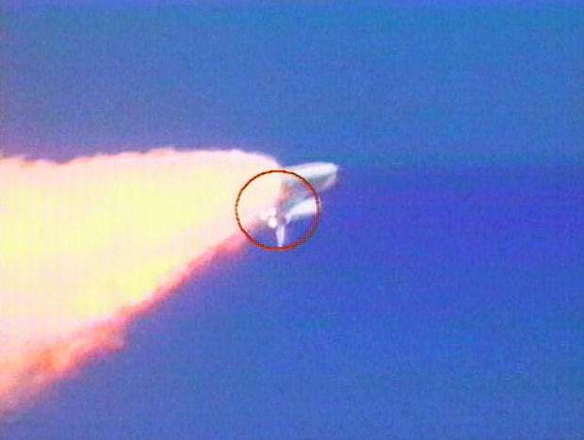
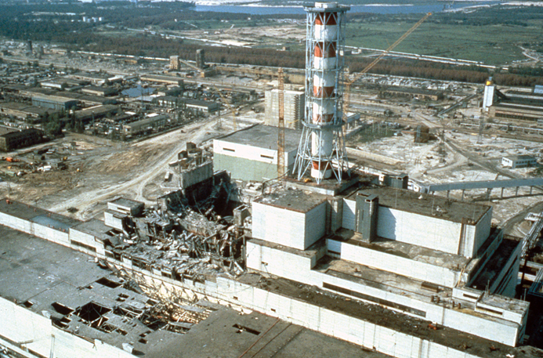
Evolution of Accident Causation Theories
Technical Period
  Equipment malfunction or other failures resulting in structural collapse, explosions, etc.
Human Error (1960’s on)
  Cognitive, perception, communication, organizational
Organizational Culture (1980’s on)
  Vulnerabilities of complex systems and a lack of focus on safety
Our approach to safety has and continues to change and evolve
Notes:
Theories of accident causation have developed through several stages.
Technical period. In this period the cause of accidents was attributed to equipment failure or malfunction.
The second stage is the period of human error where faults of human operators resulted in accidents. The most prominent accident attributed to human error is the Three Mile Island Nuclear Power Plant accident in the 70’s which resulted in a partial reactor core meltdown and was a turning point in the nuclear power industry. The accident triggered numerous research on human error in industry and academia and a tremendous amount of information.
Recently we have seen the development of Organizational Culture period. This recognizes that operators are not performing their duties or interacting with technologies in isolation. Rather complex systems require operators to perform as a coordinate team of people embedded within a particular culture. 1986 accidents: Space Shuttle Challenger explosion and Chernobyl nuclear power plants (fatalities, impact on food supplies in western USSR and Europe. The term SC was coined after the Chernobyl disaster.
SC is intended to direct attention to safety, highlight threat to safety, create context where people feel safe to speak up and act in ways to improve safety.
Summary BOX. New concepts are being introduced but they are off-shoots of SC

Slide 4
Cultural Typology
REGENERATIVE
Safety is how we do business around here
Chronically Aware
PROACTIVE
Anticipating and preventing problems before they happen
Increasing Awareness
Increasing Trust
CALCULATIVE/BUREAUCRATIC
We have systems in place to manage all hazards
Messengers are: shot ….. listened to if arrived … trained
New ideas are: crushed … present problems … welcomed
People: do not want to know … may not find out … actively seeking information
REACTIVE
Safety is important and we do a lot every time we have an accident
PATHOLOGICAL
Who cares as long as we’re not caught
Chronically Complacent
Ref: Westrum 1998, 2004
Notes:
Ron Westrum of Eastern Michigan University has provided one of the most influential work on cultural Typology.
You see the various types of culture that go from power-oriented, low-cooperation, complacency to somewhere in the middle where we have rule-oriented, modest cooperation, narrow responsibility and eventually to an informed, high-cooperation, and flexible organization.
Lets look at 3 aspects … people, messengers, and new ideas
If you look at these behaviors and consider about your organization, I think you can likely find such behaviors in different parts of the organization or in individuals for that matter.
- IF TIME story to share: two identical, sister nuclear power plants withe identical designs, operating procedures, and built at the same time. However, one plant is experiencing multiple shutdowns, near-misses and significant scrutiny and inspection by the regulators and the other is an example of a consistent performer without any shutdowns and receiving one of the highest safety ratings assigned by the regulators. The difference is the organizational culture.

Slide 5
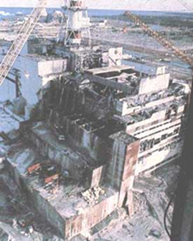

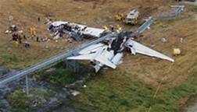

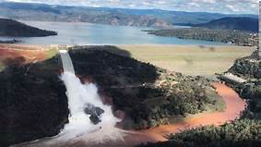
Recent Evolution of Safety Culture
1986 Chernobyl
86-03 Challenger/Columbia
Multiple Crashes
1991 IAEA, & 2011 NRC
2012 DOE Standards
2015 NASA Standards
2008-2013 FAA Standards
1999 “To Err is Human”
2009 Washington DC
2017 Oroville Dam
2009 Health Industry Std.
2010-2014 Safety Culture Reviews and Changes
2017 ICOLD Standards
Many other industries have adopted safety culture (e.g., Construction, oil and gas)
5
Notes:
- The first major reference to the term “Safety Culture” was after the Chernobyl disaster in 1986.
Took 5 years for the International Atomic Energy Agency to come up with standards and another 10 years for the Nuclear Regulatory Commission, which is responsible for oversight and safety of nuclear power plants developed policies with Department of Energy following suite.
it took almost a decade for the industry and regulators to conduct research, discuss different approaches, conduct pilot testing and implement and monitor the implementation of SC. NRC has now assigns an SC performance rating for plants.
NASA started focusing on SC after the Columbia accident. A decade later, SC was formally adopted through issuing policies and requirements, conducting surveys, and making changes.
Healthcare industry has recognized the importance of safety culture to saving lives and the cost of mistakes made. They have focused on using FAA’s approach relying on the use of checklists in conducting critical operations.
Rail industry. The fatality resulted in the transportation safety board identifying a lack of safety culture as the root cause. The organization asked NRC to conduct an assessment of its safety culture, which resulted a number of major changes but is still work in progress.
The 2017 Oroville dam incident (or near miss) was a wake up call to the industry. Amongst many specific technical issues, the Independent Review report identified a weak safety culture as one of the reasons.

Slide 6


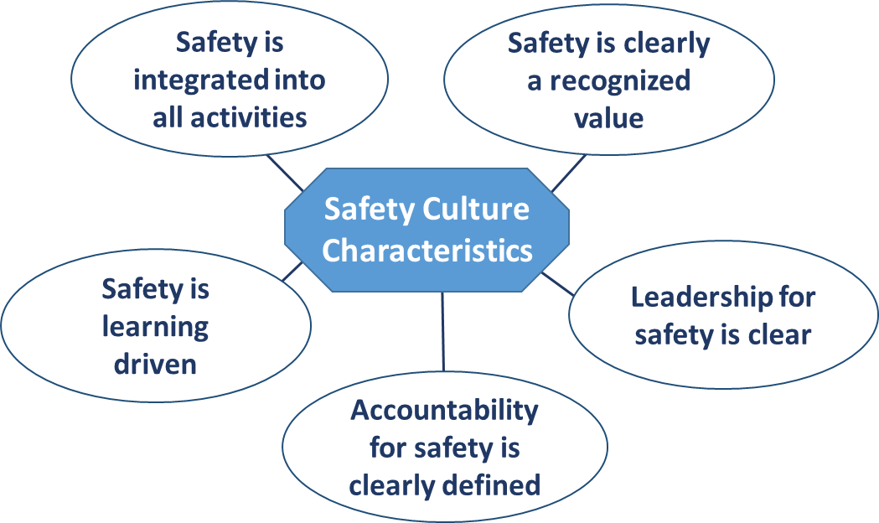
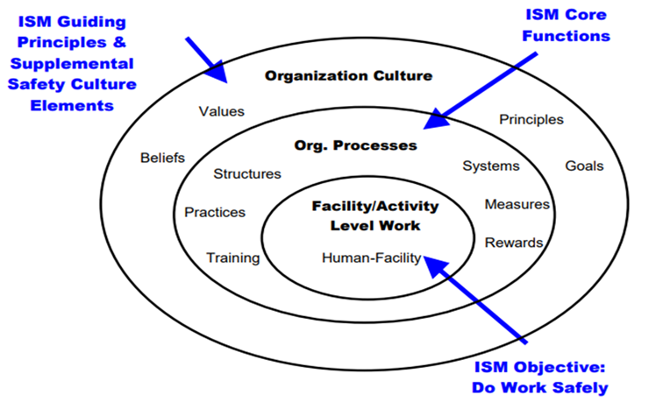
Approaches to Safety Culture
Space
Healthcare
Nuclear Power Plants and Facilities
Aviation
Notes:
NASA’s approach
Healthcare developing check lists for critical operations (like aircraft pilots) developed by Dr. Gwande of Brigham Women's hospital and a writer for new York times.
Interaction between doctors and nurses
Cultural change occurred as they were developing the checklists with nurses not wanting to challenge the doctors and doctors not wanting to lose face. Eventually, the common objective of “patient safety” forced cooperation and change of attitudes and behaviors …. at least in those cases. There is a lot of research in this area ….
Aviation industry integrating SC into its safety management system
Nuclear – the framework developed by IAEA and adoped by NRC and DOE …. More on the next slide

Slide 7
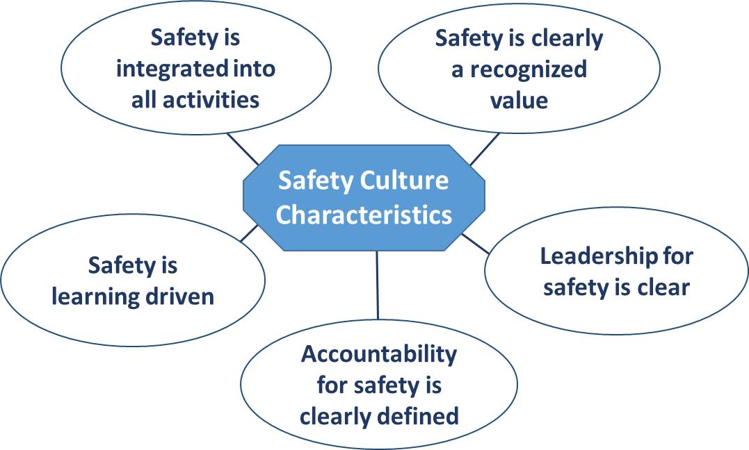
Dam Safety Management Framework
Safety Culture is:
“…that assembly of characteristics and attitudes in organizations and individuals which establishes that, as an overriding priority, protection and safety issues receive the attention warranted by their significance.” [IAEA]
Ref: ICOLD Bulletin 154, 2017 (adopting IAEA framework)
Notes:
Lets start with a definition of SC …. Form IAEA…. Lets read it slowly
Here is the framewok adopted by ICOLD for dams; comes from nuclear power industry, which has the most mature SC and extensive experience. Lets read through a couple of these attributes
Leadership for safety requires that all levels of management, especially senior management, be clearly committed to safety. Involvement of management in all safety aspects is clearly visible and the organization ensures that the necessary skills are available. The organization strives for relationships built on trust, full openness, good communication and efficient conflict resolution mechanisms.
That safety is a clearly recognized value can be reflected by high priority given to safety in allocation of resources and in business plans. High priority to safety also has to be clearly shown in communication and decision making. The entire staff has to be convinced that safety is at least as important as production and management at levels should reinforce safety conscious behavior and encourage social acceptance.
Clear accountability for safety requires that ownership of the safety concept be evident at all levels of the organization and refer to the entire workforce. Roles and responsibilities are clearly defined and understood, and delegation of responsibility and authority is carried out in a way that ensures clear accountabilities at all levels. Level of compliance with regulations and internal safety procedures is high.
Learning driven attribute …..encourages constructive and questioning attitudes and open reporting of deficiencies. Tracking of safety performance indicators and their evaluations in order to develop individuals competencies. Training, benchmarking, and self assessment used to stimulate learning and improve performance.

Slide 8
Framework for Developing Safety Culture
Define Safety Culture for your organization
Establish Safety Culture Principles considering:
  Leadership provides clear expectations and accountability, risk-informed decision making, open communications and environment free from retribution
  Employee/Worker engagement, including personal commitment to safety, participation in work planning and improvement, awareness of hazards and controls
  Organizational learning, including performance monitoring, use of operational experience, questioning attitude, problem reporting
Assess Safety Culture through surveys, interviews, focus groups, incident reports, root causes, etc.
Reassess .... continuous improvement
Notes:
Define SC …. From slides
Highlight “risk-informed decision making”
Highlight the importance of assessment and continuous improvement. It is not a one-shot deal

Slide 9
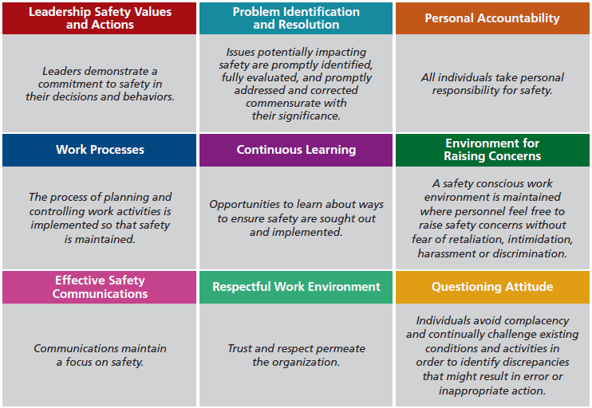
Example of Safety Culture Principles
Ref: U.S. Nuclear Regulatory Commission
Notes:
NRC is evaluating and rating SC at each plant in these areas
Highlight commensurate with importance

Slide 10
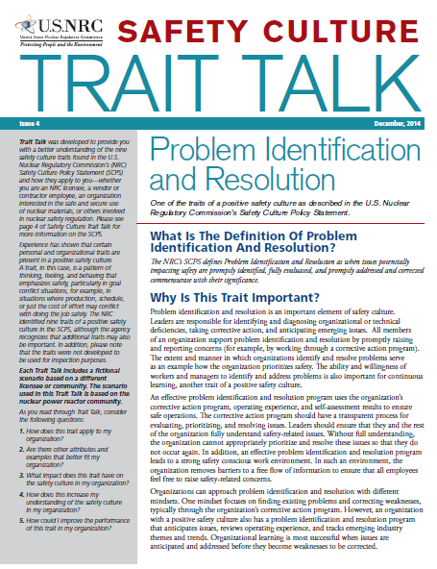
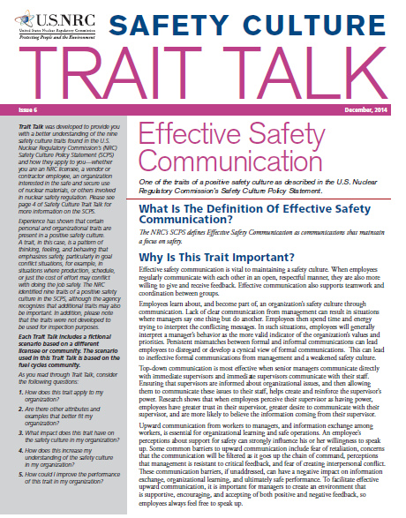
Examples of Communicating Principles
Ref: U.S. Nuclear Regulatory Commission
Notes:
Examples; note the graded approach in problem identification and resolution.
I should say the NRC does a lot more, including workshops, periodic assessment internally and inspection by the regulators and assignment of a rating for each power plant, including SC into all other periodic inspection of plants ,….
Since 1986 when focus was places on organizational culture, SC seems to have become embedded into many activities of 100 power plants, companies supporting the plants, and the regulatory body – NRC itself.

Slide 11
Evolutionary Nature of Safety Culture
Gradual process requiring a change in thinking and behavior ……… takes time
The assessment and feedback process provides a forum not only for communication of ideas and information but also the buy-in
It is founded upon having accurate and accessible information regarding the design basis of the program/project
Notes:
Gradual process example. Note the Boeing 737 MAX that has been grounded and likely affected the travel plans of most of us as the FAA and Boeing grounded all 737MAX aircraft.
Although it may be premature to jump to any conclusion at this time, it seems FAA and Boeing ignored the first crash, then blamed the pilots in the second crash until a report cleared the pilots of any error (they followed Boeing’s procedures), and finally the COE of Boeing accepted responsibility (although FAA is lagging). All this happened less than 5 years after they embraced SC. …. It is work in progress…

Slide 12

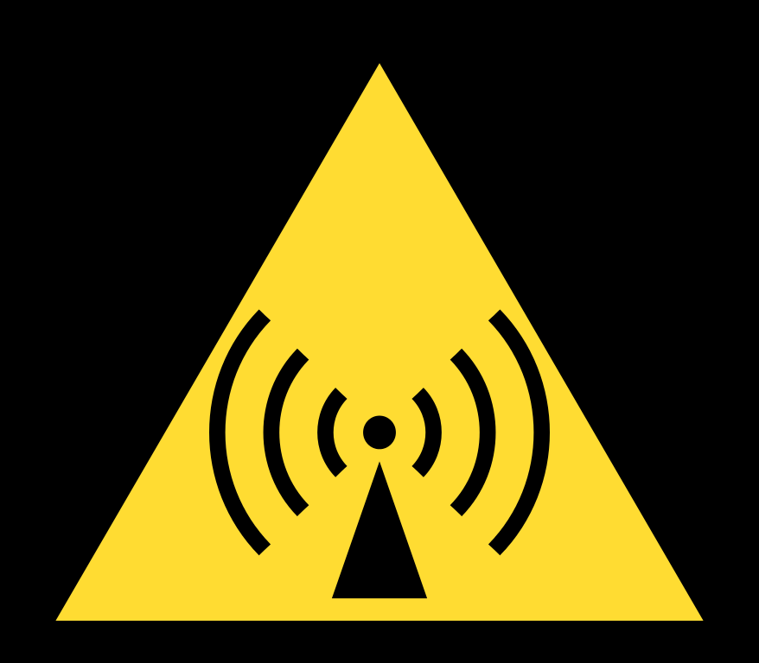
Safety Culture and Safety Management
Attributes of Safety Culture manifest themselves in Safety Management System processes and activities
Integrated risk-based Safety Management System
  Identify risks
  Analyze,
  Assess,
  Manage, and
  Communicate them
Defense-in-depth
  Safety Limit
  Limiting Conditions for Operations
  Operating Limit
  Job-specific Limits
External
Events
Notes:
Defense-in-depth: multiple layers of protection
Need to have identified, analyzed, assessed, managed, and communicated risks. Boeing 737 did not have any redundancy which is required for any critical system and sometimes even triple redundancy!
I have noticed some dams are using similar terms as Operating Basis equivalent to Limiting conditions for Operations

Slide 13
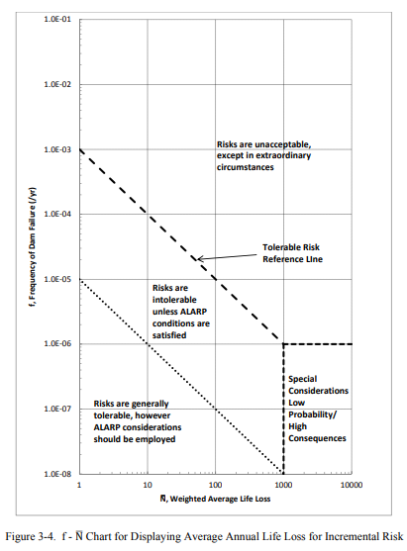
Risk Informed Decision Making
FERC Interim Guidance (2016) - Draft Risk Informed Decision Making Policy Guidance Documents
Risk analysis
Risk assessment
Risk management
Risk communication
FERC and industry moving forward:
Workshops
Practices for different topics and configurations
Pilot studies
Ref: FERC Interim RID Guidelines Chapter 3, Risk Assessment
Notes:
The concept of RIDM is something that is relevant to not only risk management but also SC. This is very similar to what the NRC initiated in the 1990’s and have instituted and made part of the nuclear power plant safety culture.
This is limited to dams that fall under FERC’s jurisdiction. But, could be and should be used by others.
It expands the scope of risk analysis and management beyond major accidents using the concept of ALARP. This under SC.

Slide 14
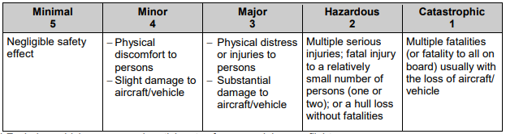
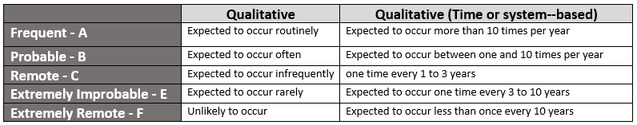
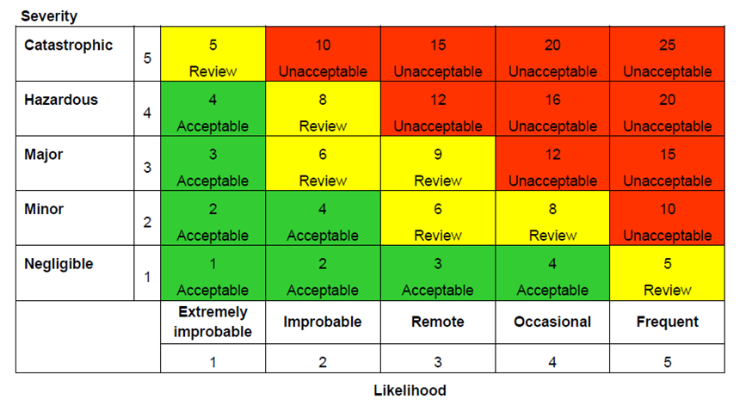
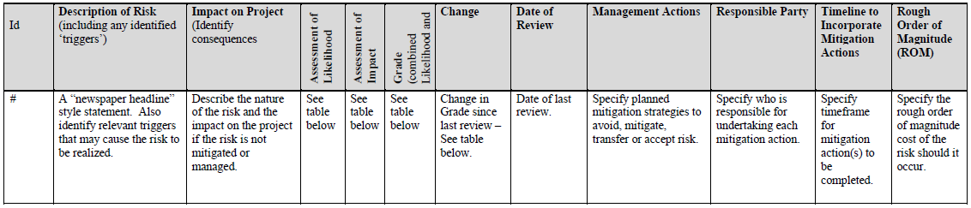
Risk Analysis & Management and Examples
Risk Identification. Systematic reviews, inputs from individuals internally and externally, lessons learned within and outside the organization
Risk Assessment. Severity, Frequency, and Risk Assignment
Risk Register
Risk Communication
Ref: USSD Construction and Rehabilitation; Risk Sharing (2017)
Notes:
Walk through the slides.
I have seen some large dam that do not have anything close to this. There is no process, like a Risk Register, to keep track of, monitor and close out identified risks. In some cases, nobody assigned the responsibility for performing such function.
It maybe helpful for the Dam industry to develop a consistent process and standards for the identification, analysis, risk assignment, and risk management of identified risks.

Slide 15
Design Basis is the Foundation
Management processes are intended to ensure a project is designed and operated within its safety limits
Without a complete and readily available safety design basis, no process or culture can be effective
Our knowledge
  Known knowns -- Things we know that we know
  Known unknowns -- Things that we know we don't know
  Unknown unknowns -- Things we don't know we don't know
Ref: Donald Rumsfeld
Notes:
Design Basis. For older projects, it is sometimes difficult to find the original design basis. This is a concern especially as people retire and institutional knowledge is lost. Some industries, such as nuclear, have gone through major efforts to reconstruct or reconstitute the original design basis of projects built in the 1940’s. They have made major efforts to reach out to the retired staff as well as the retiring staff to capture and transfer their knowledge. Many projects still have a Mr. or Ms. so and so who has been there from day one and knows it all and every body goes to them to get insights.
Known-knowns etc. Lets use a simplified example with a switch that you flip to close a gate.
If you flip the switch, the gate closes. That is some tinging you know you know.
If you flip the switch and the gate does not close and there is no reason you can think of for that response, then you know there is something that you know you do not know. That is where inquisitiveness of SC comes in and what you and the organization does with that information. What if you flip the switch again and it works this time. Would you ignore the first incident? That is where SC comes in to perform the necessary analysis, determine the root cause, and remedy the issue. Also, provide Lessons Learned to other dams so that they can investigate their situation.
Unknown unknowns. This is a tough one, if you do not even know it exist how could you know anything? One example that I can think of is receiving a Lessons Learned report, in a database or some meeting, from another dam that may trigger a thought and pushes the issue into Known unknowns.

Slide 16

Summary and Conclusion
Every organization has a culture; it’s a matter of the nature and stage of evolution (e.g., compliance-based, regenerative)
Improving SC is a gradual process requiring leadership commitment, assessment of current culture, questioning attitude, and institutionalizing a continuous improvement process
It is imperative to establish and document design basis of projects so that risks are identified, analyzed, assessed, managed and communicated
Peoples attitudes and opinions have been formed over decades of life and cannot change by a few meetings or giving a few lectures Mao Tse Tung
Notes:
- It requires commitment at all levels of organization. Its development and the buy-in process IS a part of developing a SC

Slide 17
Backup Slides

Slide 18
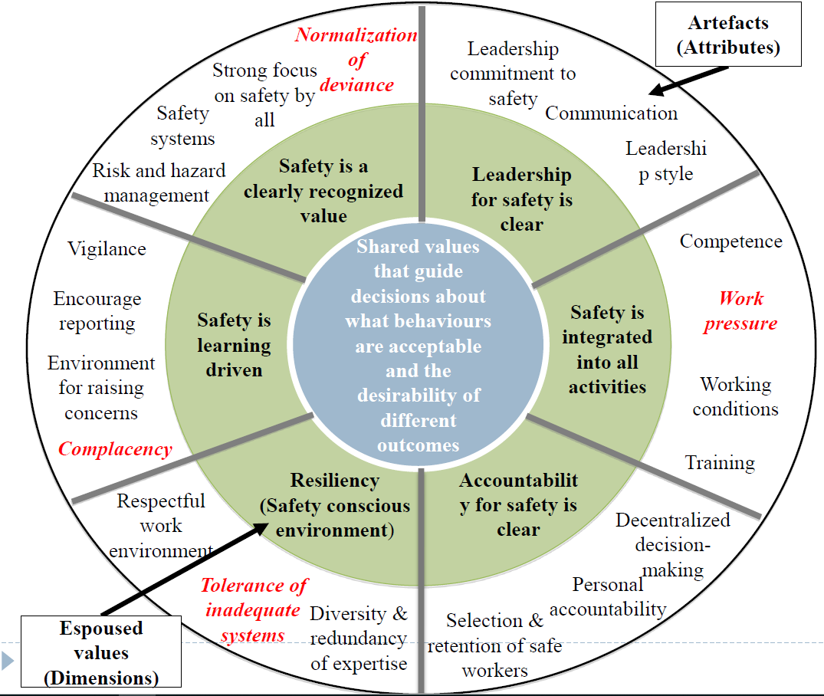
Cultural Causes of Disasters
Review of 17 offshore disasters to identify cultural causal factors
14 disasters contained cultural causes
Tolerance of inadequate systems and resources (10)
Normalization of deviance (9)
Complacency (8)
Work pressure/ cost (4)
Ref: M. Fleming, 2010
Notes:
Using the ICOLD-adopted general framework, a 2010 review of offshore accidents provides a breakdown of the root causes of accidents within the SC framework
Decentralized decision making …. Pros and cons with centralized approach

